Slide 1


SiFri–Mail
A PERTINENT COMMUNICATION AND CATEGORIZATION TOOL THROUGH THE E-MAIL PROTOCOL USING NATURAL LANGUAGE PROCESSING AND SUPPORT VECTOR MECHANISM
Friolo, Christian C.
Imperial, Luis Anton P.
Sicad, Timothy Allen N.
C

Slide 2


PROJECT CONTEXT
1
Email is an essential tool
In today's digital landscape, email has become an essential communication tool, with billions of messages exchanged daily.
2
But using it is challenging
in terms of effectively managing and categorizing incoming messages. This issue is particularly problematic in professional settings, where efficient communication is crucial for productivity.
3
Exploring advanced solutions
Natural Language Processing techniques enable systems to comprehend and process human language with a high degree of accuracy, making it possible to categorize emails based on their content rather than just keywords.
4
Hence, SiFri–Mail was born
By using NLP and SVM, SiFri-Mail aims to automatically categorize emails, enhancing efficiency and ensuring that important messages are prioritized.

Slide 3


Why SiFri–Mail?
Purpose and Description
Increased Efficiency
Doing Busywork For You
Processing Information Faster
The purpose of the SiFri-Mail project is to create an intelligent tool that streamlines email management by automatically categorizing emails based on their content.
The tool aims to improve the overall efficiency of managing large volumes of emails, reducing the time and effort required for manual sorting, and helping users maintain a more organized and functional inbox.
This enhanced email management will contribute to better communication and productivity, especially in environments where the timely processing of information is critical.

Slide 4

Sub–Problem 1:
Reliability
Sub–Problem 2: Accuracy vs. Speed
The Main Problem
Problems to Solve
The inefficiency and inaccuracy of current email management systems in handling the growing volume and complexity of email communications.
Our proposed app would need to adapt to evolving email content and user needs over time to protect our the interests of our target user base and avoid reliability concerns.
The system should be able to balance accuracy and speed in processing large volumes of emails without compromising on either of the two.
Use of Advanced Technologies
Scalability
Practicality
By developing better systems, we strive to improve productivity, reduce wasted time, and ensure that critical communications are not lost behind the clutter.
To conduct user testing and feedback collection to refine the tool’s user interface and functionality, ensuring it meets the practical needs of its users across different platforms.
Objectives
The project must ensure the scalability of the system in handling large volumes of emails without compromising processing speed or accuracy.
T

Slide 5

What will this study cover?
What will this study not cover?
(Scope and Delimitation)
Effectiveness
The primary objective is to assess the effectiveness of sentiment-based email classification to improve user prioritization and management of emails.
The feedback will be gathered through structured online surveys hosted on Google Forms, focusing on user experience, accuracy of email categorization, and overall satisfaction with the tool. Questions will cover the clarity of categorization, perceived accuracy, ease of use, and areas for improvement.
Data Collection
Technical Specifications
Delimitation of this study excludes the technical specifications of the application, such as programming languages and platforms used. The research will not explore technical development or backend processing.
Interface Design
Questions unrelated to sentiment accuracy, such as in-depth technical feedback on interface design, will not be included in the survey.

Slide 6



Review of Related Literature and Studies
Classifiers as a Tool of Nation-Building
1
Support Vector Machine (SVM) algorithms have been used to classify riverbank land covers, detect plant diseases and help enrich our use of precolonial alphabets.
Email’s Vulnerabilities Are Exploited
2
Social engineering and other attacks relying on human error can compromise important data for malicious purposes.
How NLP Comes Into Play
3
NLP helps computer understand our language. It goes hand-in-hand with text analytics, which is used to derive new variables that may be used as inputs to predictive models.

Slide 7
Design and Methodology
The waterfall model provides for the division of the software development process into multiple phases. By creating a design prototype and defining requirements early on in the process, the project can and avoid hasty modifications that can derail the entire team’s workflow.
Research Paradigm
The overall design of the SiFri-Mail email app project consists of a user interface that presents a user’s inbox, other folders, and customization settings.
More will be presented later.
Project Design
With the use of Visual Studio Code and the JavaScript and Python programming languages along with their libraries, the software was built starting with the development of a classification model that utilizes the SVM algorithm.
Project Development
L

Slide 8


DEVELOPMENT PLANNING
Software Used
Visual Studio Code is a lightweight but powerful source code editor which runs on your desktop and is available for Windows, macOS and Linux.
Firebase is a platform backed by Google to build & run modern, AI-powered experiences users love, with managed infrastructure and provided tools to optimize an app’s quality and experience.
Languages Used
Python is an interpreted object-oriented programming language, comparable to Perl, Ruby, Scheme, or Java. It uses an elegant syntax by prioritizing indentation, which promotes the development of logical codebases.
JavaScript is the default programming language of the Web. It was designed with a write-once-run-anywhere approach, with debuggers built into popular browsers such as Chrome and Edge.

Slide 9

EVALUATION OF THE PROJECT
Respondents of the Study
1
Students from the Greater Manila Area (NCR, Cavite, Laguna, Rizal and Bulacan), at least 18 years old, can read and type, and have a computer with stable Internet.
Questionnaire and Survey
4
Survey sampling was selected as the method to acquire information from the target demographics.
Research Instruments and Techniques
2
Survey questionnaires, distributed with Google Forms.
Efforts to increase the quantity of respondents through public information campaigns on social media and chat.
Evaluation Scale
5
The researchers used the Likert scale to evaluate the performance of the system.
Data Gathering
3
We used the data gathered to analyse the benefits and shortcomings of their software project. This will be used to improve the application software in future iterations.
Questionnaire Medium
6
Conducted on Google Forms. Platforms used for the dissemination include Facebook, Messenger, and Discord.

Slide 10
RESULTS
5 POINT LIKERT SCALE SCORING RANGE
 | VALUE | RANGE
Strongly Disagree | 1 | 1.00 - 1.80
Disagree | 2 | 1.81 - 2.60
Neutral | 3 | 2.61 - 3.40
Agree | 4 | 3.41 - 4.20
Strongly Agree | 5 | 4.21 - 5

Slide 11
5 POINT LIKERT SCALE SCORING RANGE
(REVERSED)
 | VALUE | RANGE
Strongly Agree | 1 | 1.00 - 1.80
Agree | 2 | 1.81 - 2.60
Neutral | 3 | 2.61 - 3.40
Disagree | 4 | 3.41 - 4.20
Strongly Disagree | 5 | 4.21 - 5

Slide 12
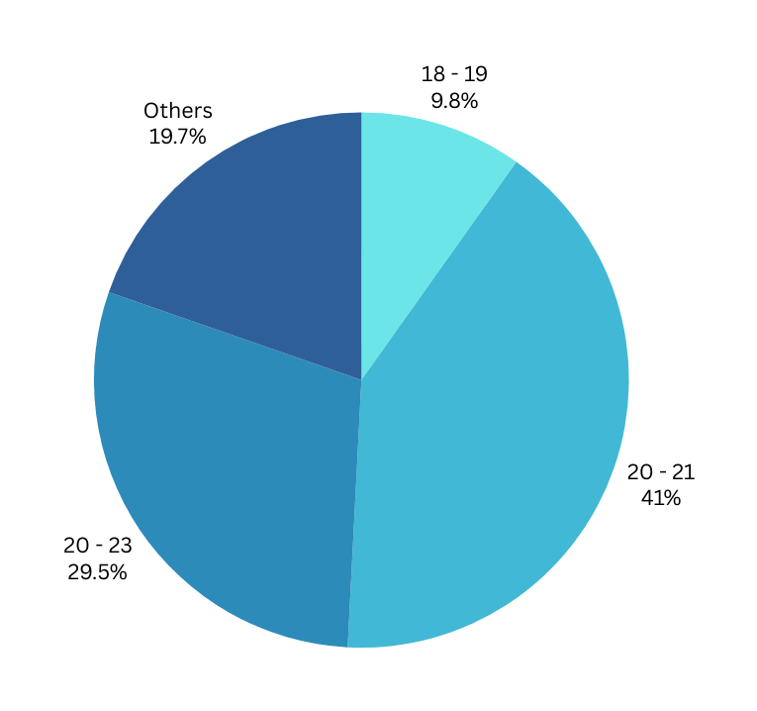
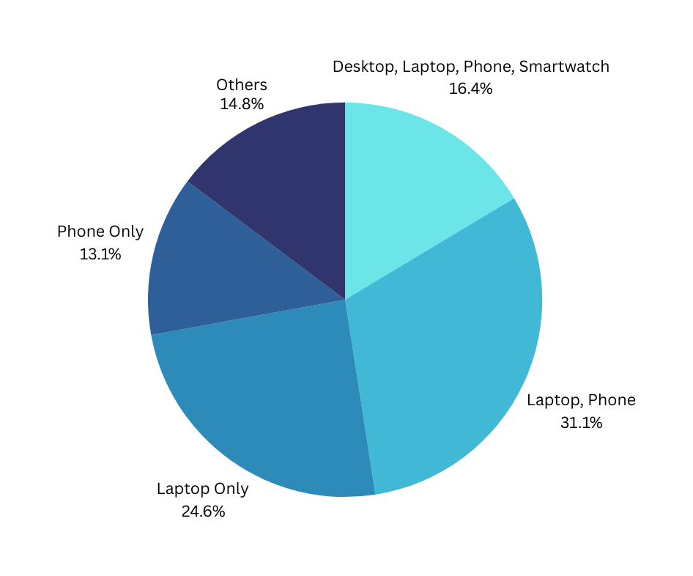
D
E
M
O
G
R
A
P
H
I
C
DEVICE
OWNERSHIP
AGE
BRACKET

Slide 13
FUNCTIONALITY
QUESTION | AVERAGE | INTERPRETATION
Q1: SiFriMail can easily synchronize my e-mail messages. | 4.30 | Strongly Agree
Q2: SiFriMail lets me compose new emails quickly. | 4.35 | Strongly Agree
Q3: SiFriMail lets me view my email folders easily. | 4.43 | Strongly Agree
Q4: SiFriMail does not classify my emails properly. | 2.92 | Neutral
Q5: SiFriMail can connect to my preferred e-mail account. | 4.43 | Strongly Agree

Slide 14
RELIABILITY
(REVERSED SCALE)
QUESTION | AVERAGE | INTERPRETATION
Q1: SiFriMail does not authenticate with my chosen e-mail service provider. | 3.78 | Disagree
Q2: SiFriMail opens my inbox every time I launch the app. | 2.67 | Neutral
Q3: SiFriMail always works with my Internet connection. | 2.62 | Neutral
Q4: SiFriMail consistently obtains my latest e-mail messages. | 2.62 | Neutral
Q5: SiFriMail reliably utilizes my configuration settings. | 2.68 | Neutral

Slide 15
USER INTERFACE DESIGN
(MIXED SCALE)
QUESTION | AVERAGE | INTERPRETATION
Q1: SiFriMail is pleasing to the eyes. (Normal Scale) | 4.07 | Agree
Q2: SiFriMail has a poorly thought-out logo and color scheme. (Reversed Scale) | 3.57 | Disagree
Q3: SiFriMail lets me access every feature I need easily. (Normal Scale) | 4.20 | Agree
Q4: SiFriMail displays my e-mails properly. (Reversed Scale) | 3.03 | Neutral
Q5: SiFriMail does not look professionally made. (Normal Scale) | 2.73 | Neutral

Slide 16
DISCUSSION AND CONCLUSION
Strengths
The application excels in simplifying email management tasks, providing a clean and user-friendly interface, and effectively synchronizing and organizing emails.
Areas for Improvement
Respondents suggested enhancements to the user interface, particularly in the visual design and inclusion of more advanced organizational features such as additional folder options or clearer iconography.
Recommendations
Examine scalability of application with bigger selection of classification models
Expand target demographic from only students. Personal use, office work, etc.

Slide 17
IT’S NOW TIME TO EXPLORE THE APP!
We hope SiFri–Mail will provide you with a quality user experience that can deliver your needs.
Friolo, Christian C.
Imperial, Luis Anton P.
Sicad, Timothy Allen N.

Slide 18
SiFri–Mail
A PERTINENT COMMUNICATION AND CATEGORIZATION TOOL THROUGH THE E-MAIL PROTOCOL USING NATURAL LANGUAGE PROCESSING AND SUPPORT VECTOR MECHANISM
Friolo, Christian C.
Imperial, Luis Anton P.
Sicad, Timothy Allen N.

